Slide 1
CodeU
Bootcamp
Welcome to your 5th session!
The class will start shortly...
Reproduction and distribution of the presentation deck is prohibited

Slide 2
Agenda for today’s class
Brief Recap
01
02
Homework Revision
To refresh our minds on what was seen last class!
Let’s revise last class’s homework!
Topic of the day:
03
04
Practice time!
Learn to use code like a pro!
Recap of conditionals
Exercises
Wrap-up
Conclusion
05
06
CodeU Robot
Summary of what we’ve learned today
homework and questions

Slide 3



Homework Solution: ONE Quiz!
# Print your question!
print('What company has built the first rocket to ever land back on Earth undamaged?')
# Define a variable for the player’s answer
answer = input('Your answer: ')
# Conditional IF
if answer == "spacex":
print("\nThat is the correct answer! You win!")
# Conditional ELSE
else:
print("\nYour answer is incorrect…You lose!")

Slide 4
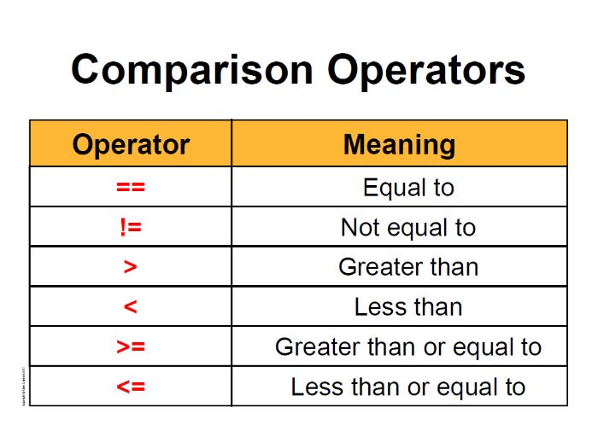
Comparison Operators
Examples
True or False
5 == 6
5 < 6
5 >= 5
5 != 6
10 > 10
10 >= 10
Comparison operators
Used to check conditions and make comparisons

Slide 5
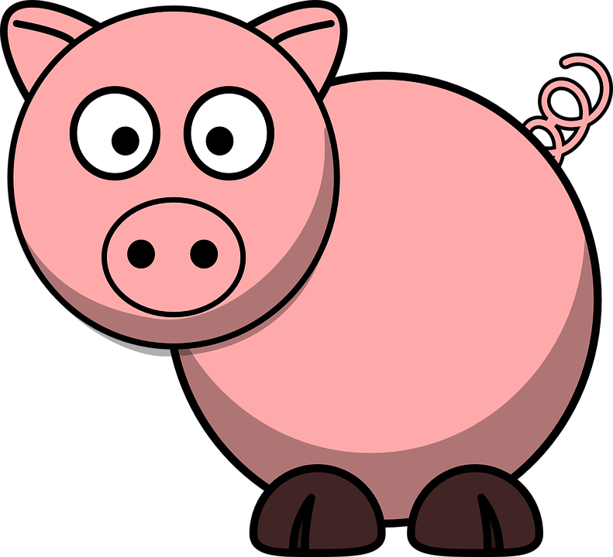


1
3
Exercise 1: Animal Sounds
Exercise 3: Rollercoaster
Step 1: Define any animal as a variable
You are the entrance clerk at the worlds tallest rollercoaster. There is an age restriction of 15 years old. If the person entering is old enough, you can let them pass. If not, they can’t ride the rollercoaster.
Step 2: Write the first condition. This will be the animal sound the computer prints depending on the condition.
Step 3: Write 2 other conditions.
Step 4: Write a FALSE condition that catches anything that isn’t in our conditions.
Step 1: Define the age of the person trying to enter as a variable using INPUT()
Step 2: Write the first condition. This will determine if they are old enough to ride the rollercoaster.
2
Exercise 2: Greater or Smaller?
Step 3: Write the other condition that determines if they are too young..
Step 1: Define any number as a variable
Step 2: Write the first condition. This will determine if the number is bigger than 100.
Step 3: Write the 2 other conditions that define if 1) the number is smaller than 100 2) the number is equal to 100

Slide 6

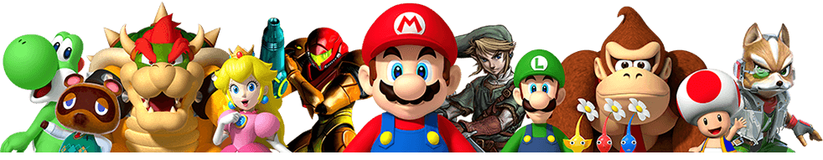
Homework: Player vs Bear! (HARD)
Homework Description
Nintendo has asked you to create a level for their video-game. The video-game is a fighting game where, on this level, the player is faced with a giant Bear and must decide what to do. They player has 3 choices: To attack, to dodge, or to scream. 1) If the player attacks, the bear dies. 2) If the player dodges, they dodge the bear's attack. 3) If the player screams, the bear attacks and they lose the game.
1
Define a variable for the player’s choice using the input() function.
4
Create the 3rd conditional: elif the player’s choice is to scream, print out “The bear has attacked you and you lost!”
2
Create the 1st conditional: if the player’s choice is attack, print out “You have defeated the bear!”
5
Create the last conditional: else -> the player’s choice doesn’t match the given choices, so print out ”Your choice doesn’t match any available choice…You lose!”
Create the 2nd conditional: elif the player’s choice is dodge, print out “You have dodged the bear’s attack and managed to escape!”
3

Slide 7




Thank you!
Does anyone have any questions?
Next class: Class 6
Please contact us if you have any questions or if you want to notify us for anything.
Phone:
(438) 391-9106
Email:
hello@codeu.ca

